Slide 1
DeepLearning approach for material failure prediction in fatigue tests using acoustic emission data
date
Ahmed Ben Sidhom
Electrical and Computer Engineering PhD candidate
Advisor: Dr. Antonios Kontsos
Director, Digital Engineering Hub (DEHub)​
Henry M. Rowan Foundation Professor ​
Dept. of Mechanical Engineering​
Dept. of Electrical Engineering (courtesy)​
Materials Science & Engineering (affiliated)​
Henry M. Rowan College of Engineering (HMRCOE)

Slide 2
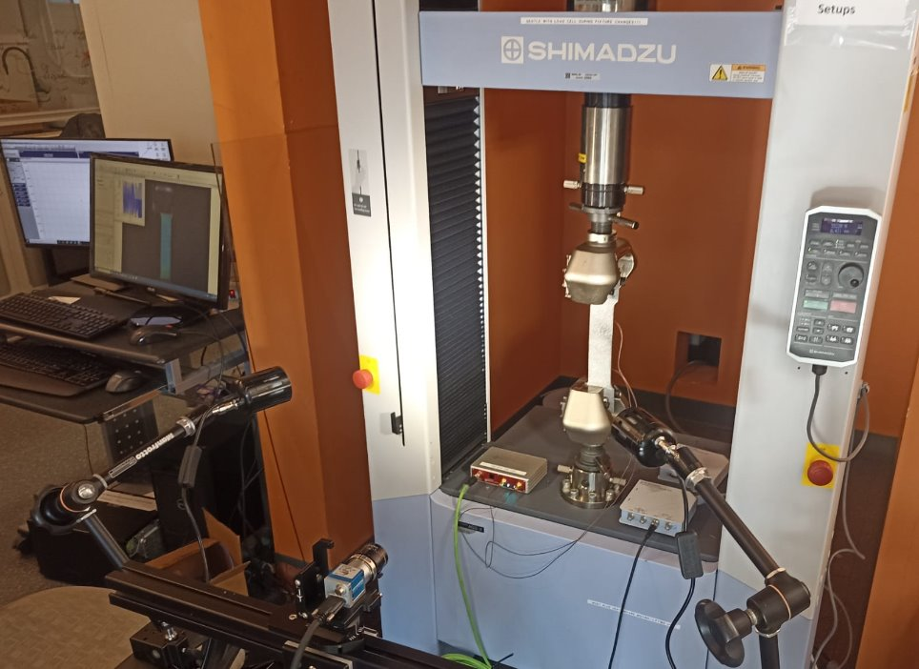
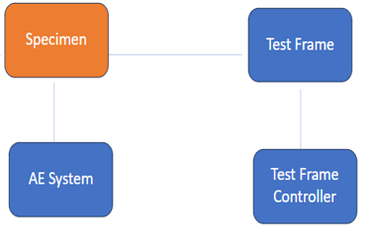
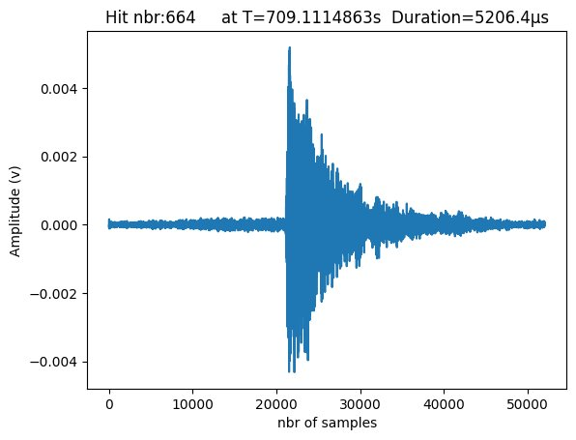
I. Problem Formulation TEST
Fatigue​
We are using mechanical testing data produced in the laboratory by means of a test frame on which we grip a material specimen. A requirement for the test frame is that it can provide to us force and displacement over time. For the Fatigue tests, the Load is the controllable parameter . The Displacement is the uncontrollable parameter, but it is measurable by the system.
Notes:
the objective is to develop and execute a fatigue experiment that enables the real-time estimation of Remaining Useful Life (RUL) for structural components. The RUL concept is crucial in assessing the longevity and reliability of materials subjected to cyclic loading. .

Slide 3
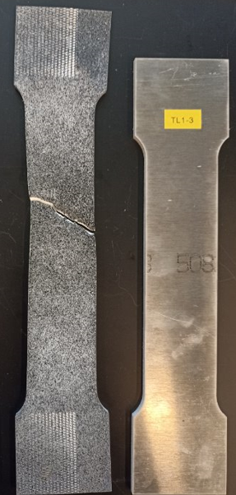
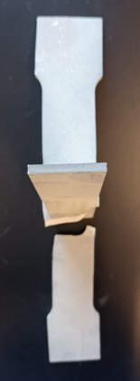
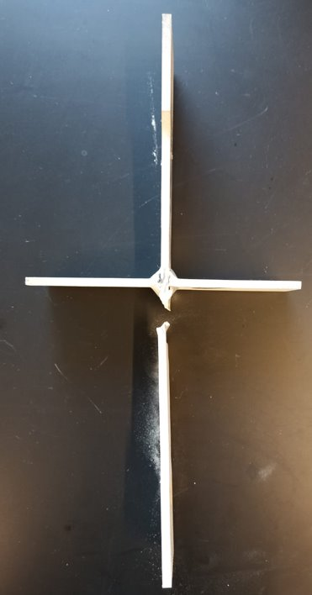
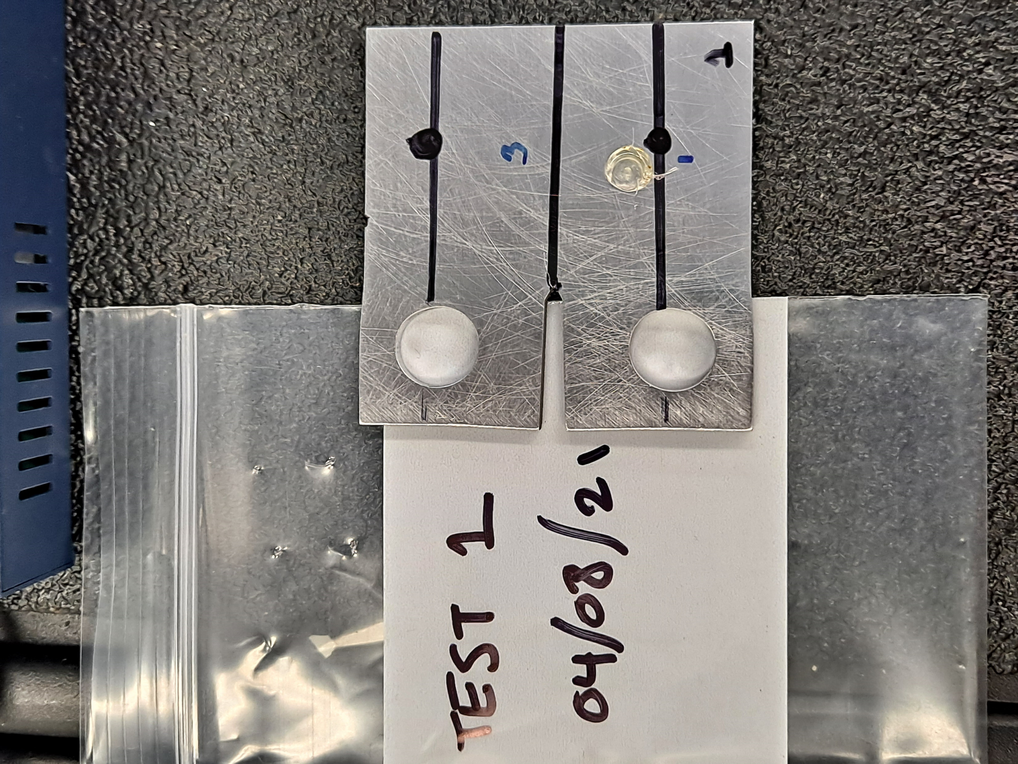
I. Problem Formulation Data COLLECTION
Dataset 1: aluminium 5083
Dataset 2: Nickel 718
7 tests
2
Dog-bone
5 Cruciform
AE waves
AE waves
D=12.75mm
50 mm
60 mm
17.75 mm
30°
60 mm
20.55 mm
17.75 mm
10.16 mm
62.5 mm
Crack
Pico Sensors

Slide 4
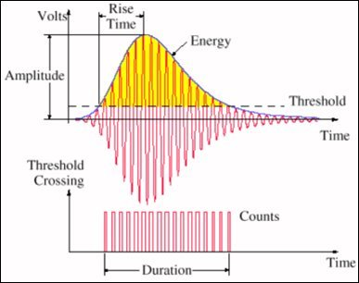
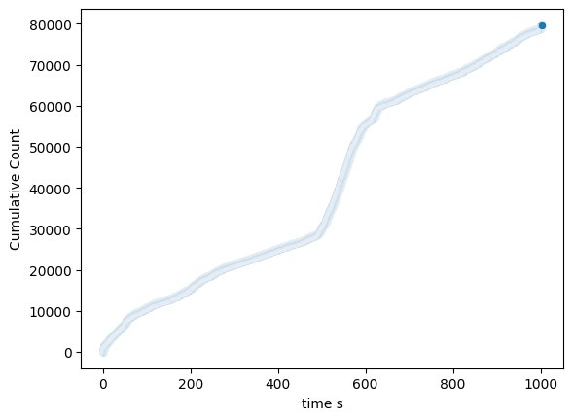
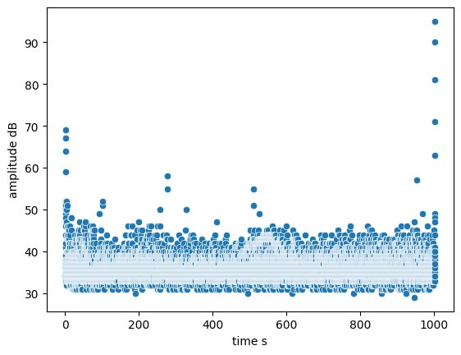
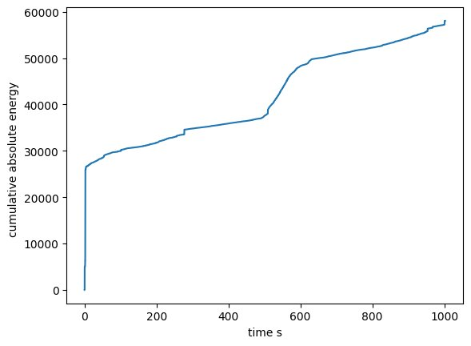
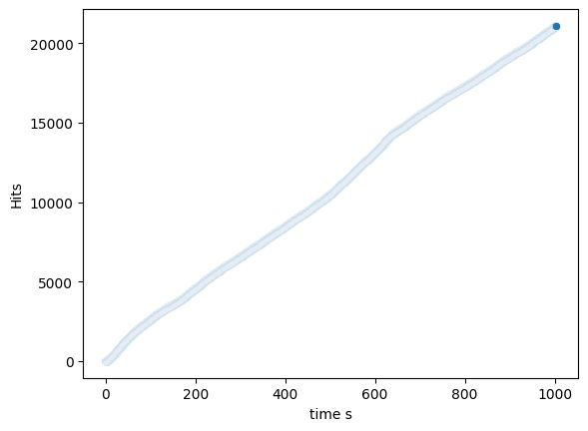
II. Data Discovery Visiualization

Slide 5
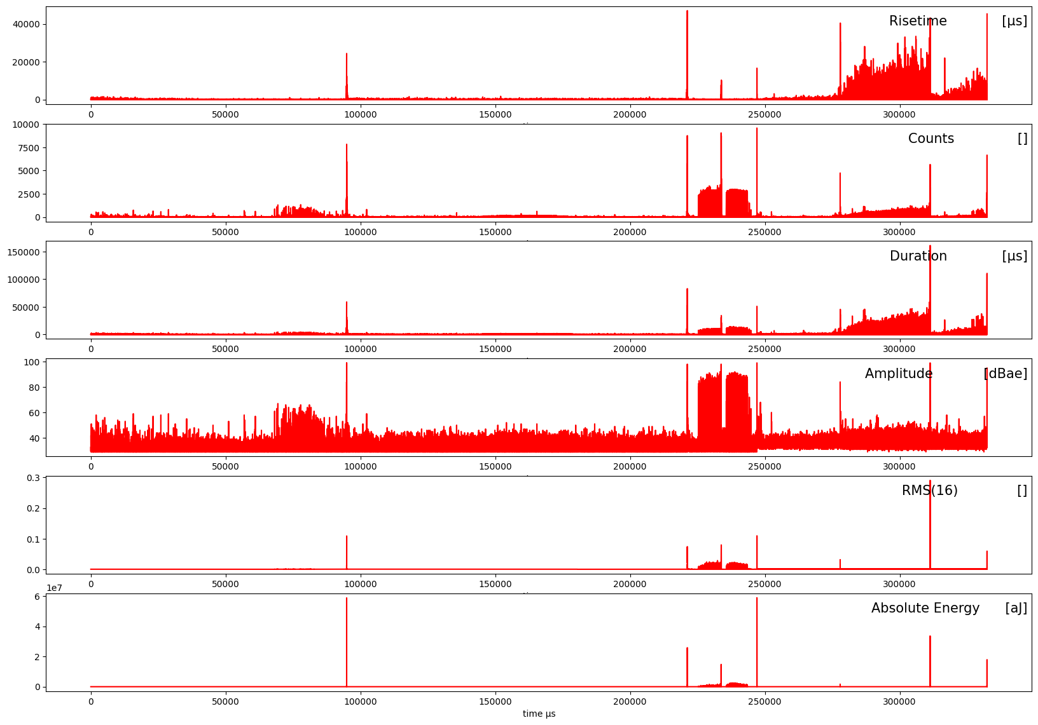
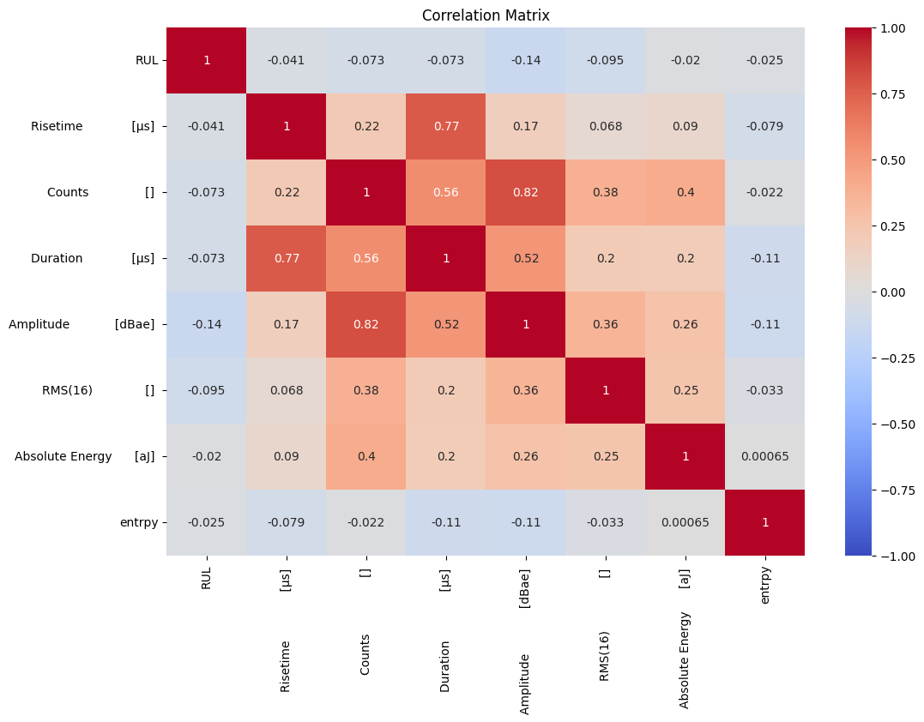
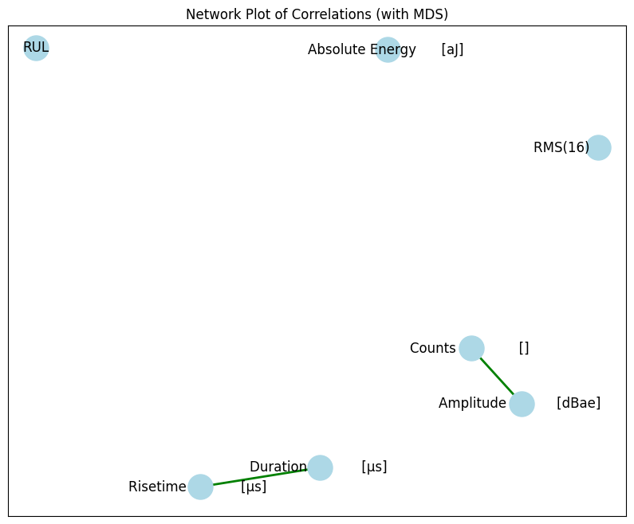
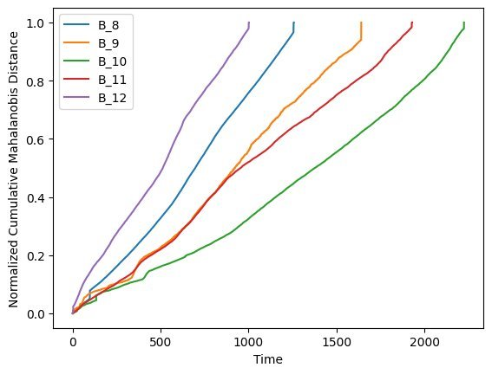
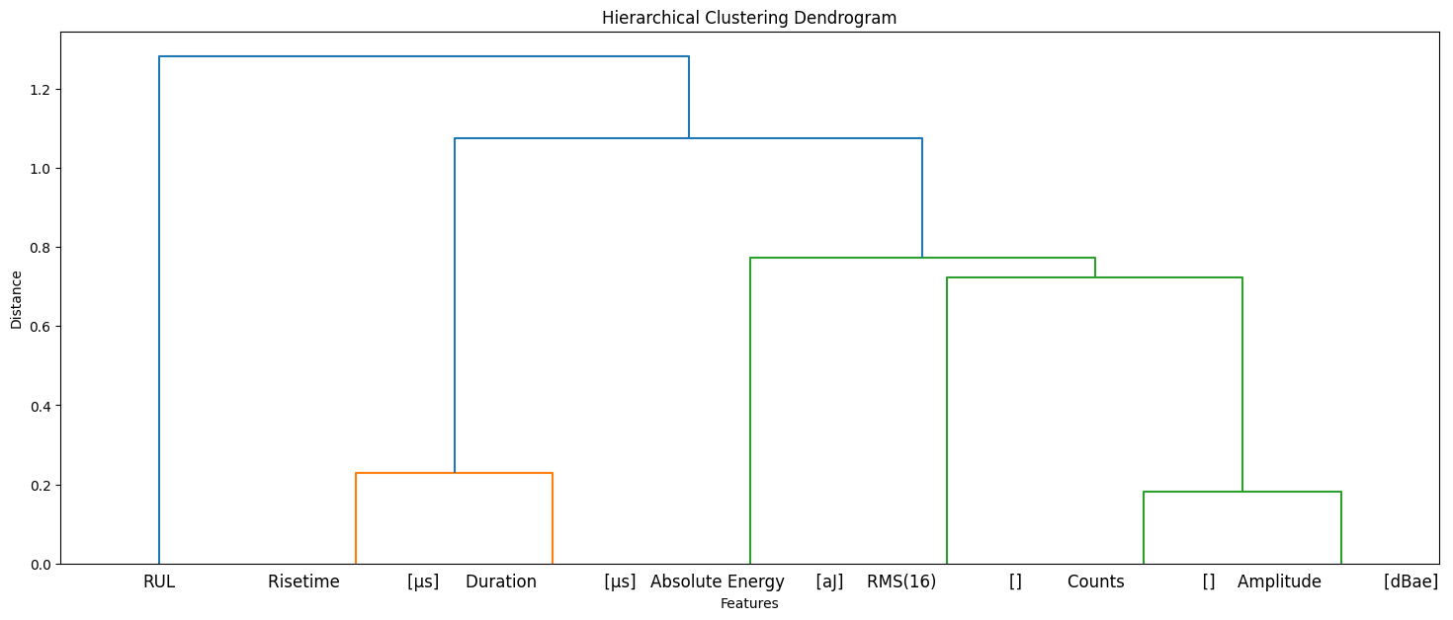
II. Data Discovery analysis: dataset 1

Slide 6
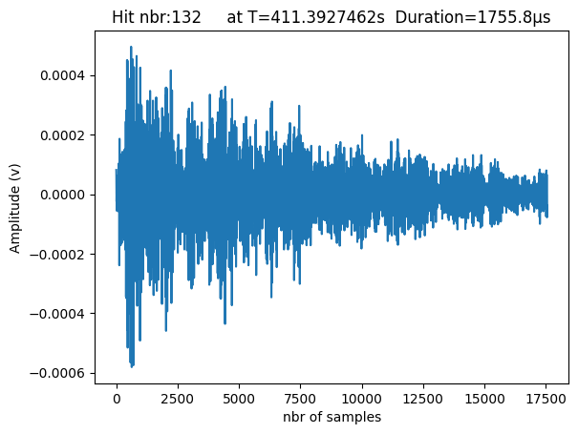
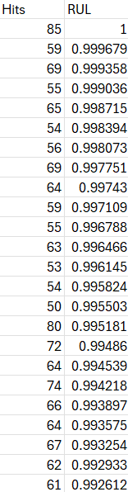

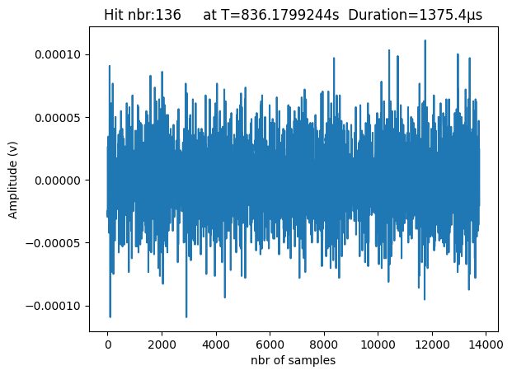
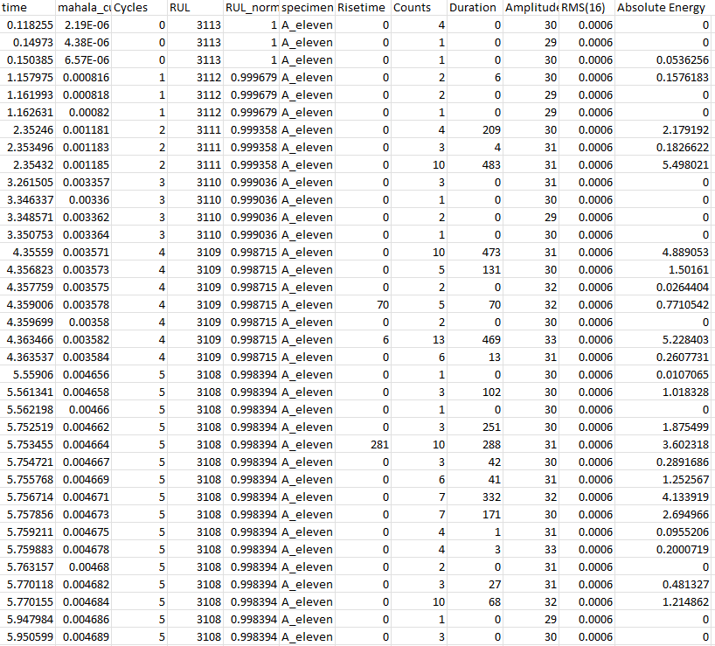

II. Data Discovery Feature extraction, data cleaning and RUL normalization
Assign a cycle for each hit using time.
Assign a RUL for each hit that we know now the total number of cycles
Normalize the RUL values between 0 and1
Count the number of hits for each normalized RUL
5. Extra: keep only the hits with max amplitude > 45db
Extra: keep the hits with count >…..
Extra: keep the hits with count/duration >…..
5
1
2
3
4

Slide 7
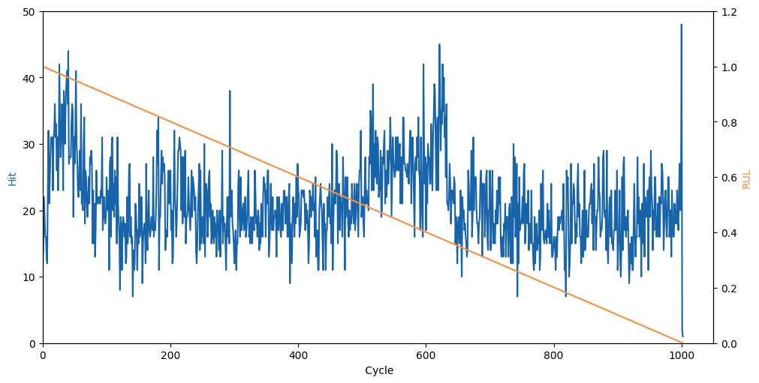
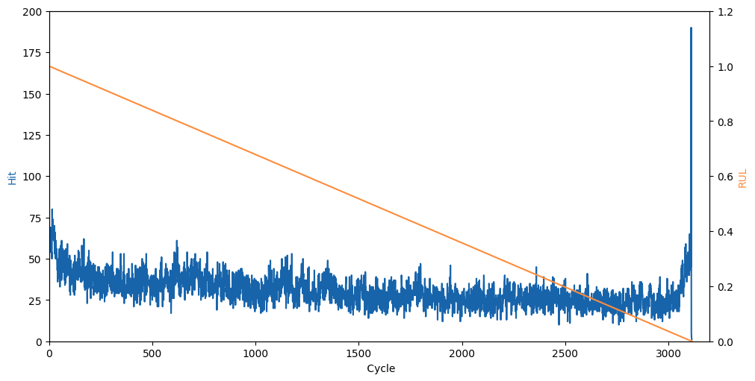
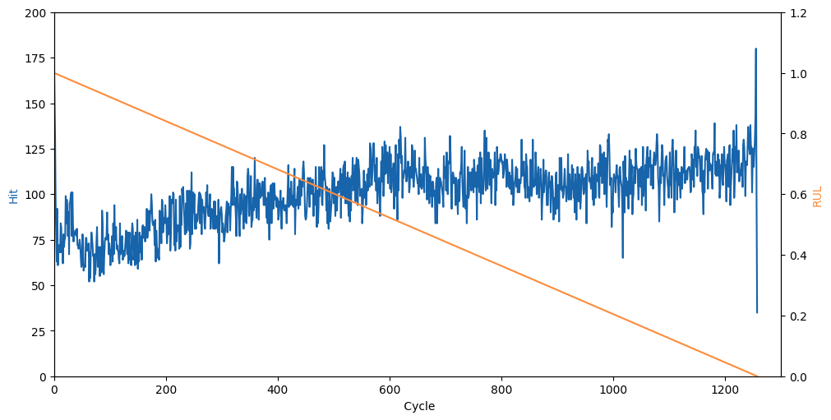
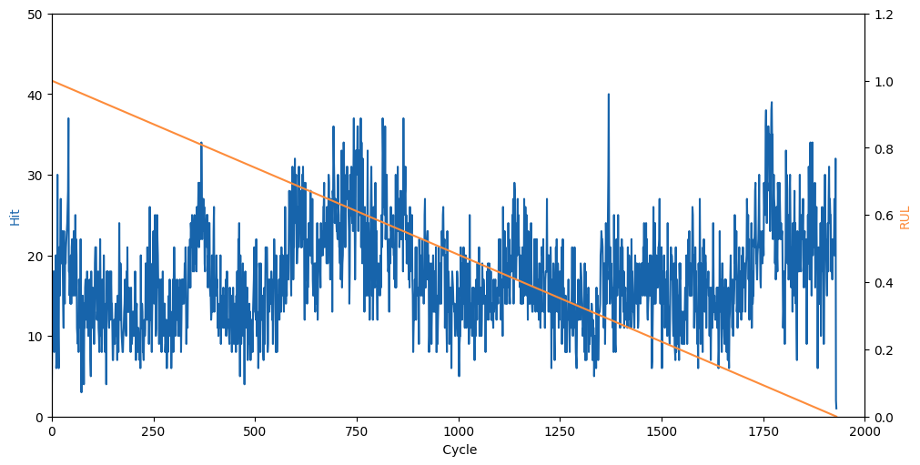
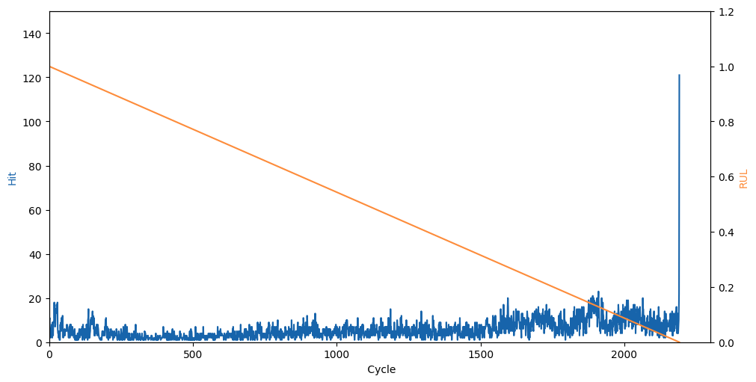
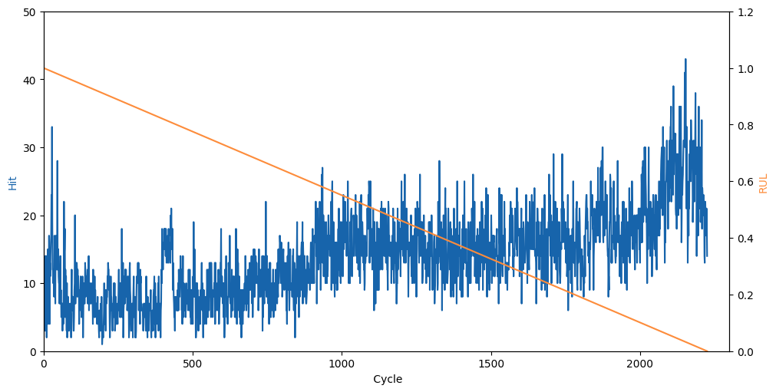
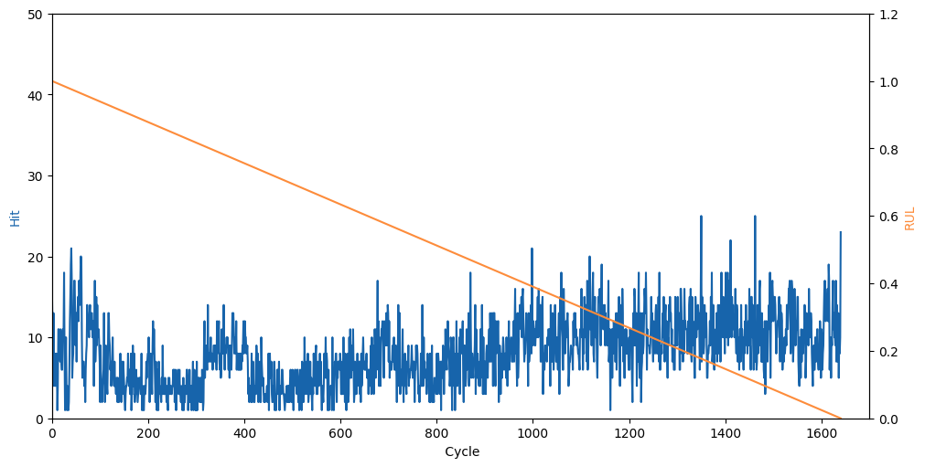
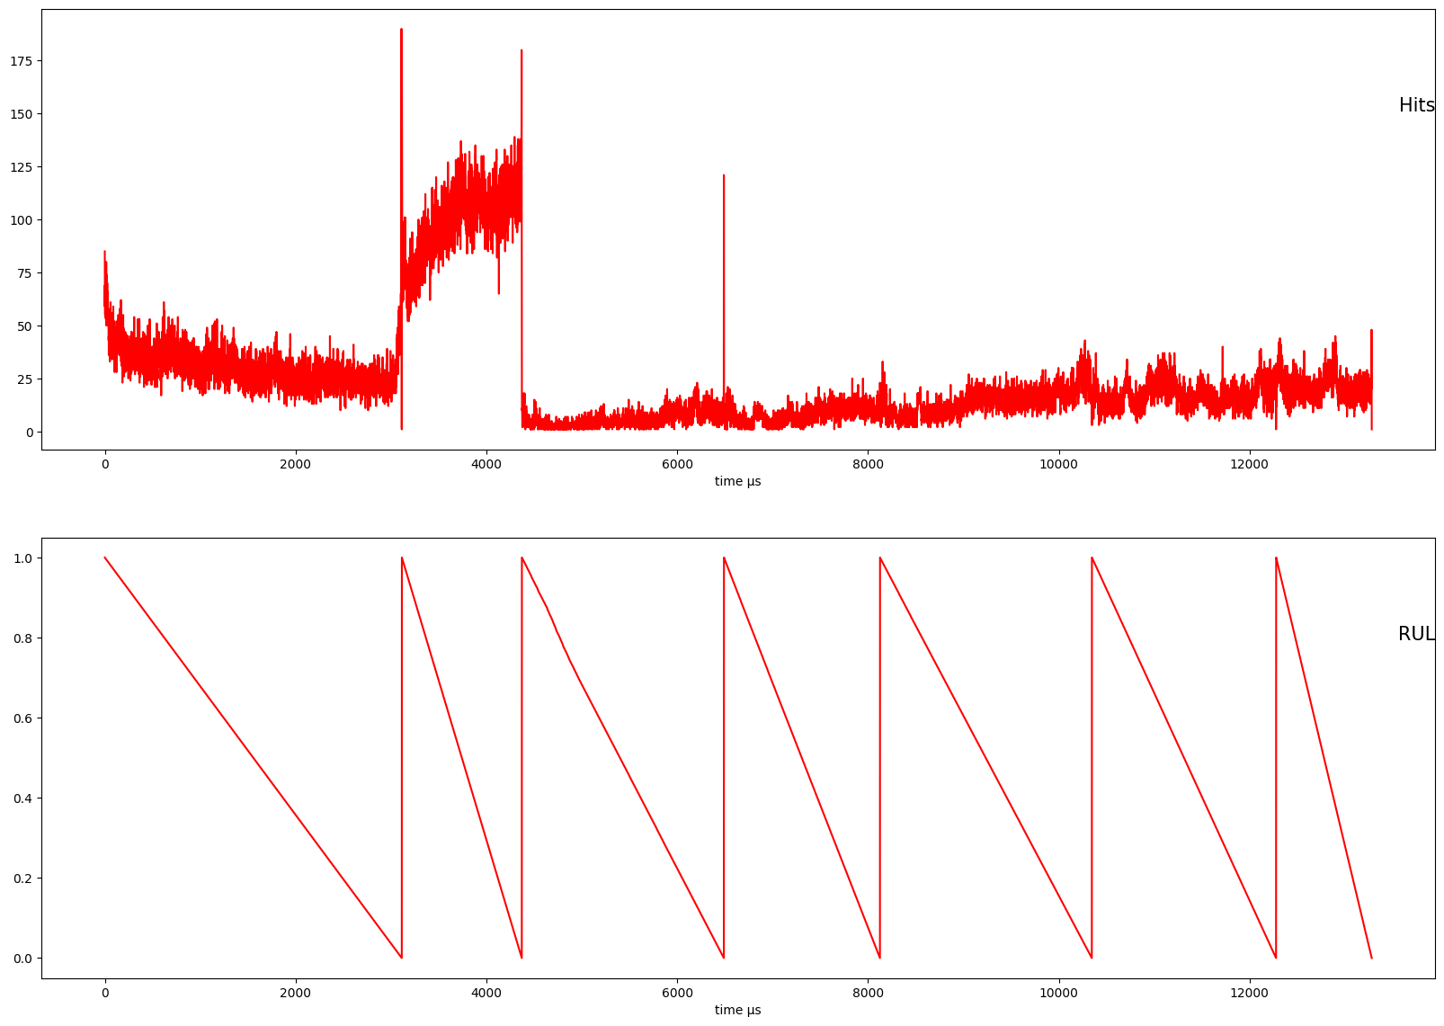
II. Data Discovery dataset 1
Bad data

Slide 8
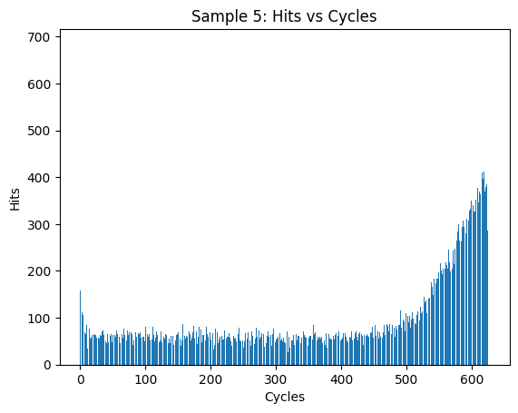
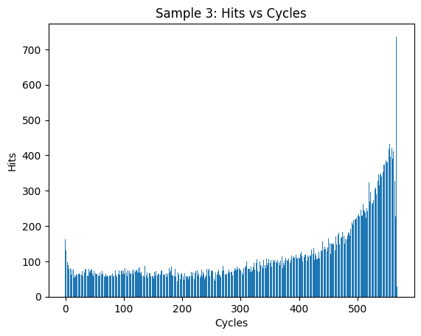
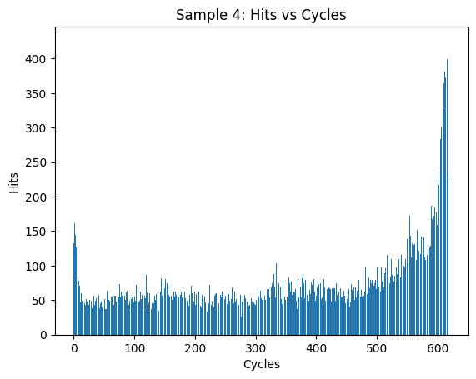
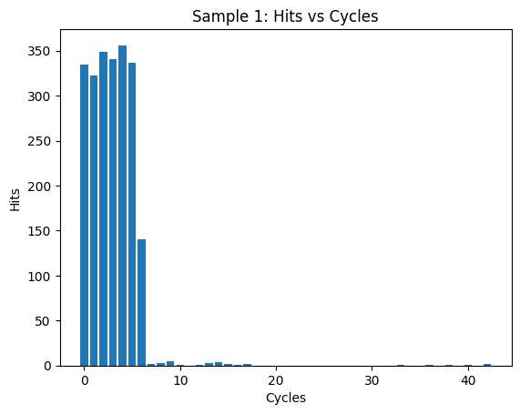
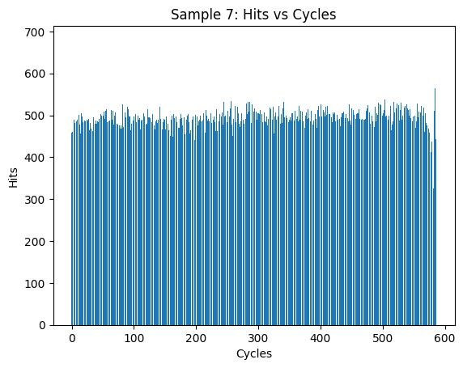
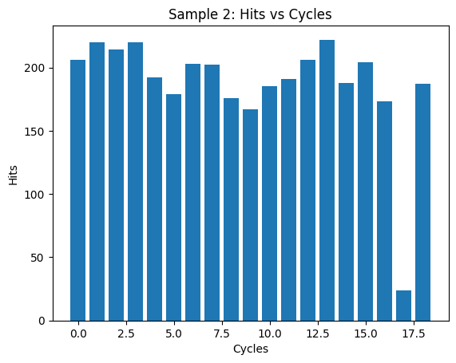
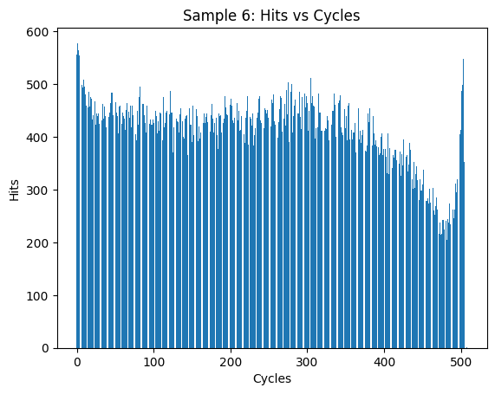
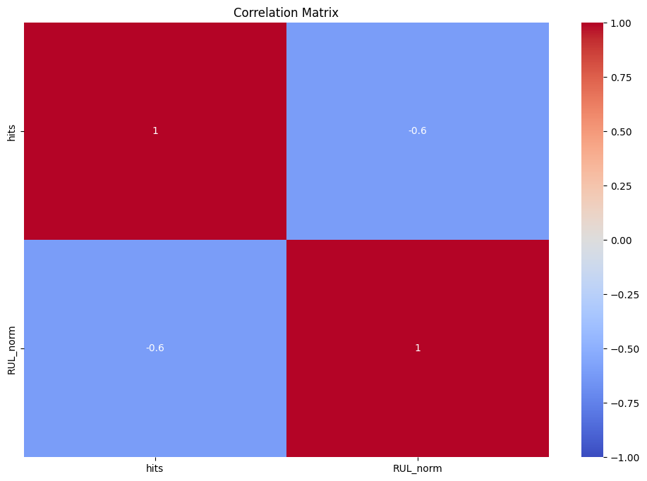
II. Data Discovery Dataset 2
Usable samples
Bad samples

Slide 9
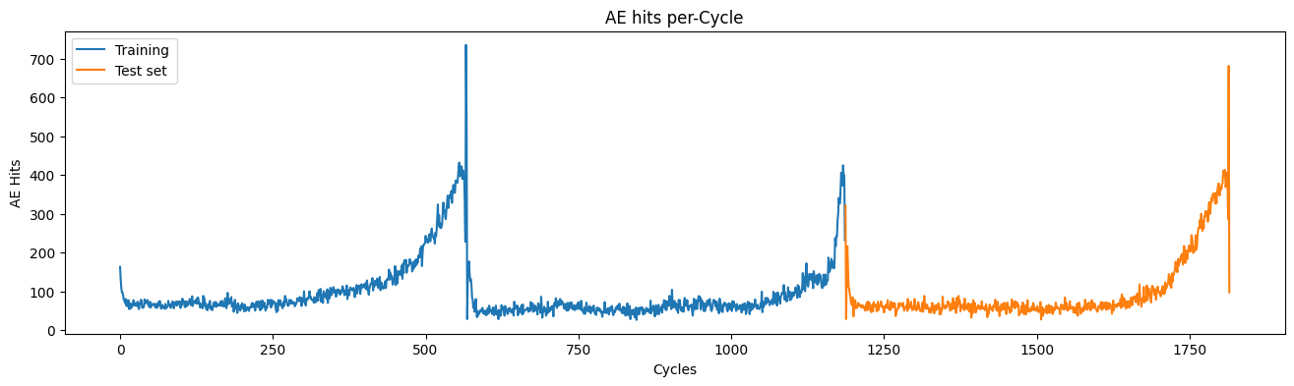
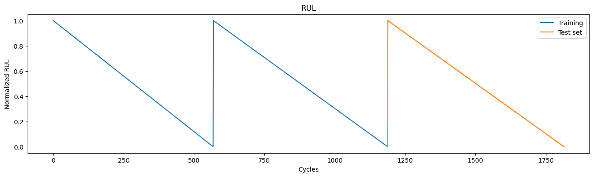
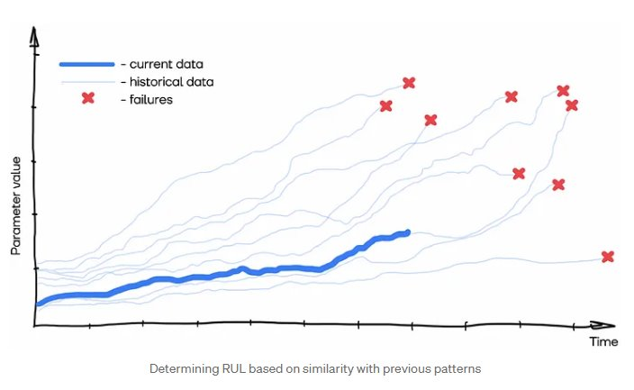
III. Approach Time series
data on operation time to failure
(i.e., the duration of operation before the failure occurred)
The desired RUL estimation will be the value of the most similar operation period from the history or the average (or any other aggregation) over a group / cluster of operation periods

Slide 10
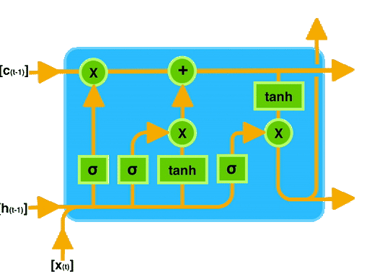
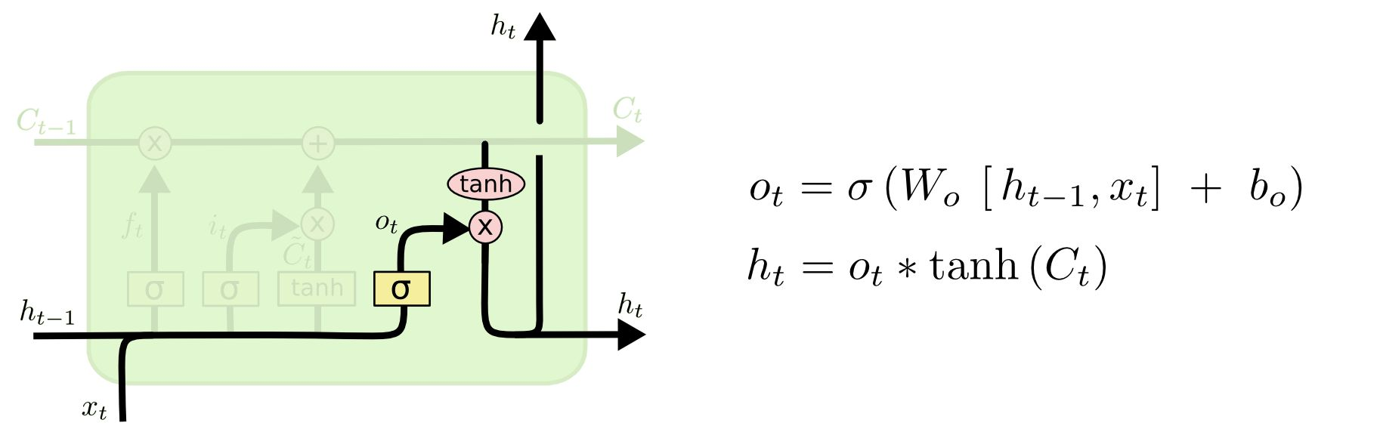
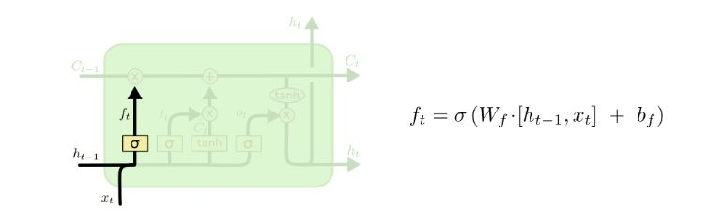
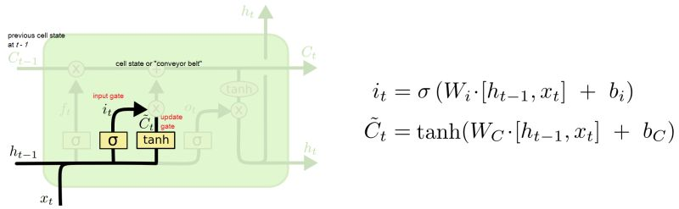
III. Approach LSTM
the Output Gate - Information Filtering: The output gate filters the cell state's information, determining what should influence the next hidden state. - State Transition: By controlling what part of the cell state becomes part of the hidden state, it facilitates smooth transitions across time steps.
The forget gate is a mechanism within LSTM cells that decides which information from the previous cell state should be discarded. This selective forgetting is crucial for preventing the accumulation of irrelevant information, which can degrade the performance of the network over time.
The Input Gate is responsible for controlling the flow of information into the memory cell of an LSTM. It decides which parts of the input data should be added to the cell state, effectively filtering out irrelevant information.

Slide 11
IV. Data preprocessing Data Labeling
LSTM input (Batch size [to compute the loss], Window Length [past steps for training]: X, number of features [sensors for examples])
LSTM output (number of prediction steps in the future: Y)
Hits
RUL
Hits
Hits
RUL
Hits
RUL
Input
Output
1
2
3
4
5
6
7
8
…
n+6
x1 | Y1
X2 | Y2
X3 | Y3
X4 | Y4
X5 | Y5
X6 | Y6
X7 | Y7
X8 | Y8
x.. | Y..
xn | Yn
Number of features= 1: Hits
Window size = 6
Overlap= 5
Prediction steps: RUL 1 step in the future
x1
x2
x3
Y1
Y2
Y3
t0
t1
t2

Slide 12
V. Training process Data normalization for real time deployment
TRAINING
training data
Split it into windows
Normalize the data using the MIN/MAX of the window
Model: training
INFERENCE
new data
Append to the prediction window
Normalize the data using the MIN/MAX of the window
Model: inference
Multiply by the MIN/MAX factor of the window

Slide 13
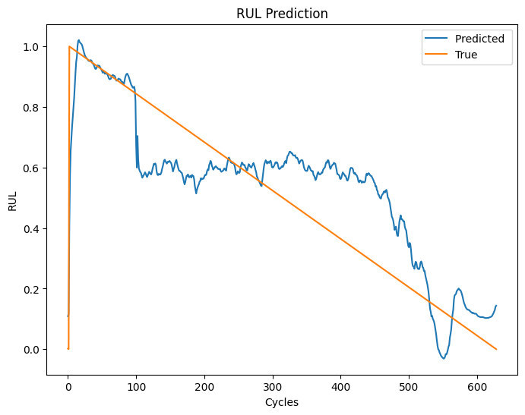
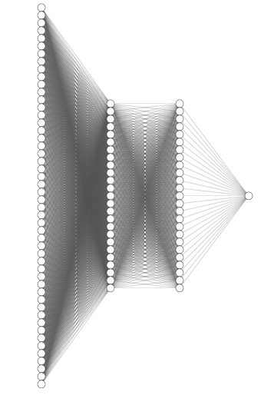
V. Training process Hyperparameters finetuning and model evaluation
Model:
3 Lstm layers 128, 50,0 50 neurons
3 dropout layers 0.2
1 dense layer with 1 neuron
Hyperparametrs:
Optimizer: adam
batch_size=50
10 epochs
Mean Absolute Error: 0.12126805577578029 Mean Squared Error: 0.02203677116764039

Slide 14
V. Results Deployement: method 1
Window size for prediction
Model
Inference: Ypred1
new sample collected from the test
Model
Inference: Ypred2
new sample collected from the test
Model
Inference: Ypred2
Window sliding in real time: remove the first value and append the new acquisition value to the window

Slide 15
V. Results Deployement: method 2 only for univaroate
Window size for prediction
Model
Inference: Ypred1
Model
Inference: Ypred2
Model
Inference: Ypred2
Window sliding in real time: remove the first value and append the new prediction value to the window

Slide 16
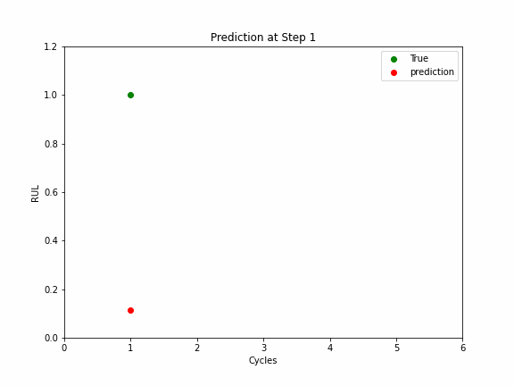
V. Results
AE DAQ
Model

Slide 17
Thank you for your attention!
Questions?
kontsos@rowan.edu
bensid28@students.rowan.edu

